Slide 1
THE CENTRAL LIMIT
THEOREM

Slide 2
Objectives
By the end of this presentation, you should be able to:
Understand what the central limit theorem is
Recognize the central limit theorem problems
Apply and interpret the central limit theorem for means

Slide 3
The Central Limit Theorem
The Central Limit Theorem (CLT) is one of the most powerful and useful ideas in all of statistics
For this class, we will consider two applications of the CLT:
CLT for means (or averages) of random variables
CLT for sums of random variables

Slide 4


The Central Limit Theorem
Suppose you roll a single die
Since the sample size is 1, the sample mean of the one roll is what you roll
The sample mean equals 4
With a different roll, the sample mean will change
The sample mean will change to 2.
Since the sample mean changes, it is a Random Variable
–
–

Slide 5
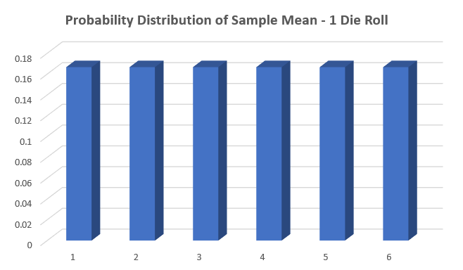
The Central Limit Theorem
Since the sample mean is a random variable, it has a Probability Distribution Function (pdf).

Slide 6
The Central Limit Theorem
The pdf has a Population mean (Ã) of 3.5, and has a Uniform Distribution

Slide 7


Two Dice
This time we are going to repeat the experiment by rolling two dice and calculating the sample mean
Sample Size = 2
Thus, the sample mean is 8 divided by 2 = 4
Again…
This time, the dice add to 7 and the sample mean changes to 3.5
Unlike the one roll case, numbers closer to the middle (like 6 and 7) are more likely to come up (why?)

Slide 8
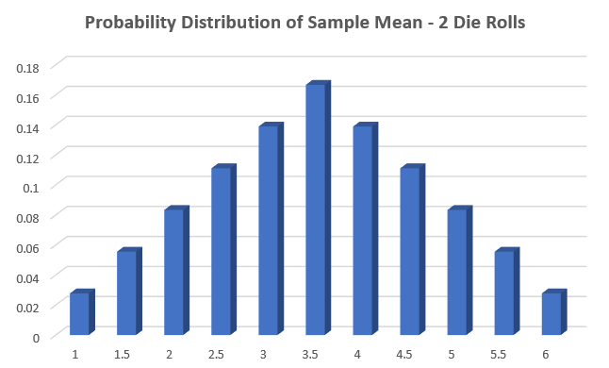
The Central Limit Theorem
This can be seen in the graph of the sample mean, which now clusters towards the population mean of 3.5

Slide 9
The Central Limit Theorem
So when the sample size increases, the population mean of 3.5 stays the same, but the pdf clusters more toward the population center – a lower standard deviation

Slide 10

Ten Dice
Finally, let’s repeat the experiment by rolling ten dice and calculating the sample mean
Sample Size = 10
The dice add to 34, so the sample mean is 34 divided by 10
= 3.4
When a large number of dice are rolled, it is far more likely to get a sample mean closer to the population mean

Slide 11
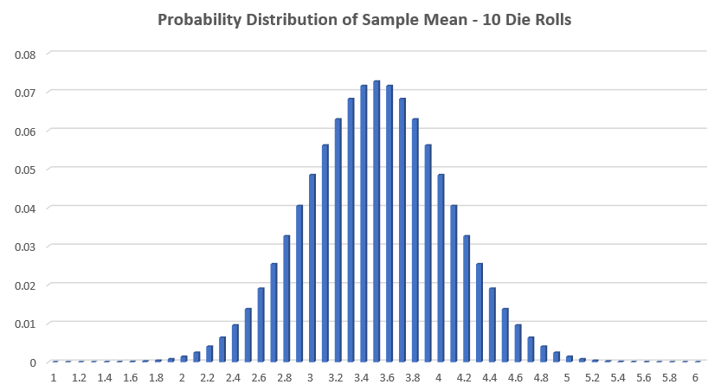
The Central Limit Theorem
Notice that the graph of the pdf of the sample mean even clusters more towards the population mean

Slide 12
The Central Limit Theorem
Even more remarkably, the shape of the pdf for the sample mean is a bell-shaped Normal Distribution, even though the original pdf was uniform rectangular

Slide 13
Three things to remember about the Central Limit Theorem:
The mean stays the same regardless of the sample size
The standard deviation gets smaller as the sample size increases
The pdf of the sample mean becomes a Normal Distribution as the sample size gets larger

Slide 14
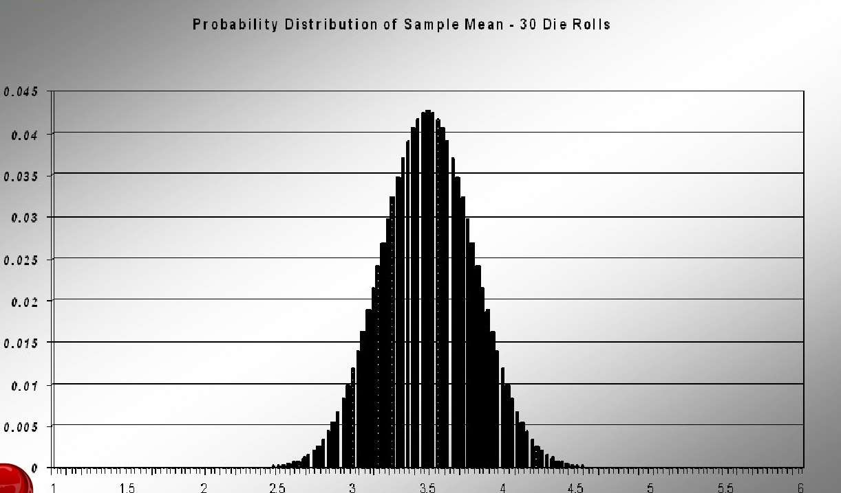
30 Die Rolls

Slide 15
Applications of the Central Limit Theorem
The Central Limit Theorem is critical to inferential statistics
In estimation, we can now determine a margin of error and a confidence interval
In hypothesis testing, we can make decisions with a known probability of making
statistical error

Slide 16
The Central Limit Theorem
- Basic Idea
Imagine there is some population with a mean Ã and standard deviation Ç
We can collect samples of size n where the value of n is “large enough”
We can then calculate the mean of each sample
If we create a histogram of those means, then the resulting histogram look much like a normal distribution
It does not matter what the distribution of the original population is.
In fact, you do not even need to know what the original distribution is!
The important fact is that the distribution of the sample means tend to follow
the normal distribution!

Slide 17

The Central Limit Theorem
- More Formally
Suppose that we have a large population with mean Ã and standard deviation Ç
Suppose that we select random samples of size n items from this population
Each sample taken from the population has its own average
The sample average for any specific sample may not equal the population average exactly

Slide 18
The Central Limit Theorem - More Formally
The sample averages follow a probability distribution of their own
The average of the sample averages is the population average:
𝜇_{𝑥} = 𝜇
The standard deviation of the sample averages equals the populations standard deviation divided by the square root of the sample size
𝜎
𝜎_{𝑥} =
𝑛
The shape of the distribution of the sample averages is normally distributed if the sample size is large enough
The larger the sample size, the closer the shape of the distribution of sample
averages becomes to the normal distribution
This is the Central Limit Theorem!

Slide 19
The Central Limit Theorem
- Case 1
IF a random sample of any size n is taken from a population distribution with mean and standard deviation Ç
with a normal
THEN distribution of the sample mean has a normal distribution with:
𝜇_{𝑥} = 𝜇
and
𝜎
𝜎_{𝑥} =
𝑛
and
𝑋 ~𝑁(𝜇_{𝑥} , 𝜎_{𝑥} )

Slide 20
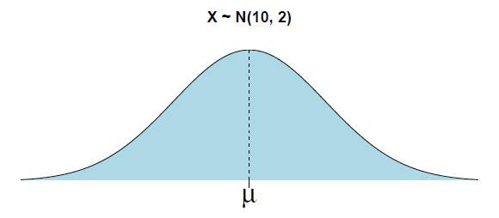
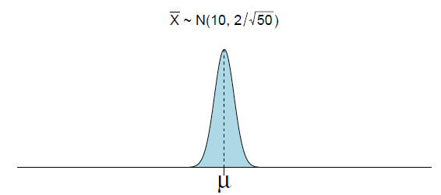
The Central Limit Theorem - Case 1

Slide 21
The Central Limit Theorem
- Case 2
IF a random sample of sufficiently large size n is taken from a population with ANY
distribution with mean and standard deviation Ç
THEN the distribution of the sample mean has approximately a normal distribution with:
𝜇_{𝑥} = 𝜇
and
𝜎
𝜎_{𝑥} =
𝑛
and
𝑋 ~𝑁(𝜇_{𝑥} , 𝜎_{𝑥} )

Slide 22
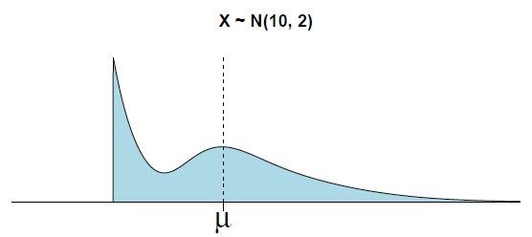
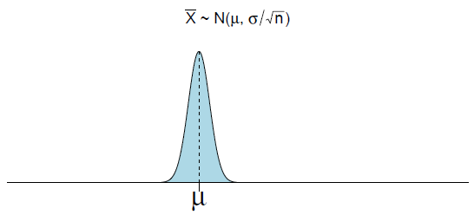
The Central Limit Theorem - Case 2

Slide 23
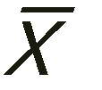
The Central Limit Theorem
-Recap
Three important results for the distribution of
The mean stays the same
𝜇_{𝑥} = 𝜇
The standard deviation gets smaller
𝜎
𝜎_{𝑥} =
𝑛
3. If n is sufficiently large,
has a normal distribution where
𝑋 ~𝑁(𝜇_{𝑥} , 𝜎_{𝑥} )

Slide 24
What is Large n?
How large does the sample size n need to be in order to use the Central Limit Theorem?
The value of n needed to be a “large enough” sample size depends on the shape of
the original distribution of the individuals in the population
Case 1: If the individuals in the original population follow a normal distribution, then the sample averages will have a normal distribution no matter how small or large the sample size is
Case 2: If the individuals in the original population do not follow a normal distribution, then the sample averages become more normally distributed as the sample size grows larger.
– In this case the sample averages do not follow the same distribution as the original populations

Slide 25
What is Large n?
The more skewed the original distribution of individual values, the larger the sample size needed
If the original distribution is symmetric, the sample size needed can be smaller
Many statistics textbooks suggest that n ù 30 is the minimum sample size to use the CLT.
In reality there is not a universal minimum sample size that works for all distributions
The sample size needed depends on the shape of the original distribution
In this class, we will assume the sample size is large enough for the CLT to be used to find probabilities for

Slide 26
The Central Limit Theorem for Sums
Suppose X is a random variable with a distribution that may be known or unknown (it can be any distribution), and suppose:
Ã_{x} = the mean of X
Ç_{x} = the standard deviation of x
The central limt for sums says that if you keep drawing larger and larger samples and taking their sums, the sums form their own normal distribution (the sampling distribution), which approaches a normal distribution as the sample increases
The normal distribution has a mean equal to the original mean multiplied by the sample size
The standard deviation is equal to the original standard deviation multiplied by the square root of the sample size

Slide 27

The Central Limit Theorem for Sums
The random variable ÆX is one sum
_{𝑧 =} 𝑥−(𝑛)(𝜇_{𝑥})
𝑛(𝜎_{𝑥})
𝑛 𝜇_{𝑥} = the mean of ÆX
𝑛(𝜎_{𝑥})=standard deviation of ÆX
With technology:
normalcdf(lower value of the area, upper value of the area, (n)(mean),
𝑛(𝑠𝑡𝑎𝑛𝑑𝑎𝑟𝑑 𝑑𝑒𝑣𝑖𝑎𝑡𝑖𝑜𝑛))
Where mean is the mean of the original distribution
Standard deviation is the standard deviation of the original distribution
Sample size = n

Slide 28
Example 7.5
An unknown distribution has a mean of 90 and a standard deviation of 15. A sample of size 80 is drawn from the population
– Find the probability that the sum of the 80 values (or the total of the 80 values) is more than 7500
Solution: Let X = one value from the original unknown population. The probability
question asks you to find a probability for the sum (or total of) 80 values.
ÆX = the sum or total of 80 values. Since 𝜇_{𝑥} = 90, 𝜎_{𝑥} = 15, and n=80,
ÆX ~N((80),(90),( 80)(15))
– Mean of the sums = (n)(𝜇_{𝑥} ) = (80)(90) = 7,200
Standard deviation of the sums = 𝑛 𝜎_{𝑥} =
Sum of 80 values = Æx = 7,500
80 15

Slide 29
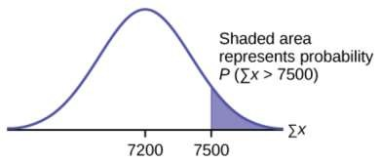
Example 7.5
An unknown distribution has a mean of 90 and a standard deviation of 15. A sample of size 80 is drawn from the population
Find the probability that the sum of the 80 values (or the total of the 80 values) is more than 7500
– Mean of the sums = (n)(𝜇_{𝑥}) = (80)(90) = 7,200
Standard deviation of the sums = 𝑛 𝜎_{𝑥} = 80 15
Sum of 80 values = Æx = 7,500
Find P(Æx > 7,500)
– normalcdf(7500, 1x10^99, (80)(90),
80 15 ) = 0.0127

Slide 30
Example 7.5
An unknown distribution has a mean of 90 and a standard deviation of 15. A sample of size 80 is drawn from the population
Find the sum that is 1.5 standard deviations above the mean of the sums
Solution: Find ÆX where z = 1.5
Take a look at part b on your own (page 380)

Slide 31

Calculating Probabilities from a Normal Distribution
Here is the general procedure to calculate probabilities from the distribution of the sample mean
1. You are given an interval in terms of , i.e.
𝑃(𝑋 < 𝑥 )
2. Convert to a z-score using
𝑥 − 𝜇
𝜎/ 𝑛
𝑧 =
3. Look up probability in z-table that corresponds to z-score, i.e.
𝑃(𝑍 < 𝑧)
This is the same idea we used in Chapter 6!

Slide 32

Example 1
Let 𝑋~𝑁(10,2)and n=100. What is the distribution of the sample mean ?
The Central Limit Theorem says: 𝑋 ~𝑁(𝜇_{𝑥} , 𝜎_{𝑥} )
– Thus 𝜇_{𝑥} = 𝜇 = 10
𝜎
2
100 10
– Also 𝜎 =
=
2
= = 0.2
𝑥 _{𝑛}
So, 𝑋 ~𝑁(10, 0.2)

Slide 33


Example 1
Let 𝑋~𝑁(10,2)and n=100. What is the distribution of the sample mean ?
Calculate the probability that P(𝑋 < 9.89)
a)
Sketch the graph. Scale the horizontal axis for . Shade the region corresponding to the probability.
– Find the z-score
𝑧 =
𝑥 − 𝜇 9.89 − 10 −.11
= = = −0.55
𝜎/ 𝑛
2/ 100
.2
– Now, look this up in z-table
We can also do with technology
– 𝑛𝑜𝑟𝑚𝑎𝑙𝑐𝑑𝑓(𝑙𝑜𝑤𝑒𝑟 𝑏𝑜𝑢𝑛𝑑𝑎𝑟𝑦, 𝑢𝑝𝑝𝑒𝑟 𝑏𝑜𝑢𝑛𝑑𝑎𝑟𝑦, 𝜇 , ^{𝜎} )
𝑥 _{𝑛}
– 𝑛𝑜𝑟𝑚𝑎𝑙𝑐𝑑𝑓(−9999999999, 9.89, 10,
– P 𝑋 < 9.89 = .2912 = 29.12%
2
)
100

Slide 34
Example 2
A biologist finds that the lengths of adult fish in a species of fish he is studying follow a normal distribution with a mean of 20 inches and a standard deviation of 2 inches.
Sketch the graph. Scale the horizontal axis for X. Shade the region corresponding to the probability in part b)
Find the probability that an individual adult fish is between 19 and 21 inches long.
Find the probability that a sample of 4 adult fish, the average length is between 19 and 21 inches. Sketch the graph. Scale the horizontal axis for . Shade the region corresponding to the probability.
Find the probability that for a sample of 16 adult fish, the average length is between
19 and 21 inches.

Slide 35
Percentile Calculations Based on the Normal Distribution
Here is the general procedure to calculate the percentile
You are given a probability or percentile desired
Look up the z-score in the z-table that corresponds to the probability
Convert to
value that corresponds to the P^{th}
by the following formula:
𝑥 = 𝜇 + 𝑧
𝜎
𝑛

Slide 36
Example 3
Emergency services such as 911 monitor the time interval between calls received. Suppose that in a city, the time interval between calls to 911 has an exponential distribution, with an average of 5 minutes and a standard deviation of 5 minutes.
Sketch the graph. Scale the horizontal axis for . Shade the region corresponding to the probability.
Find the probability that the sample average time interval is between is between 4 and 6 minutes, for sample size n = 36

